Slide 1




Week-2 (Discussion)
4th Feb, 2025
Deep Learning
Prof. Sudarshan Iyenger
Professor and Head of the Department
Department of Computer Science and Engineering
IIT Ropar
Ayan Paul
PMRF Research Scholar
IIT Kharagpur

Slide 2
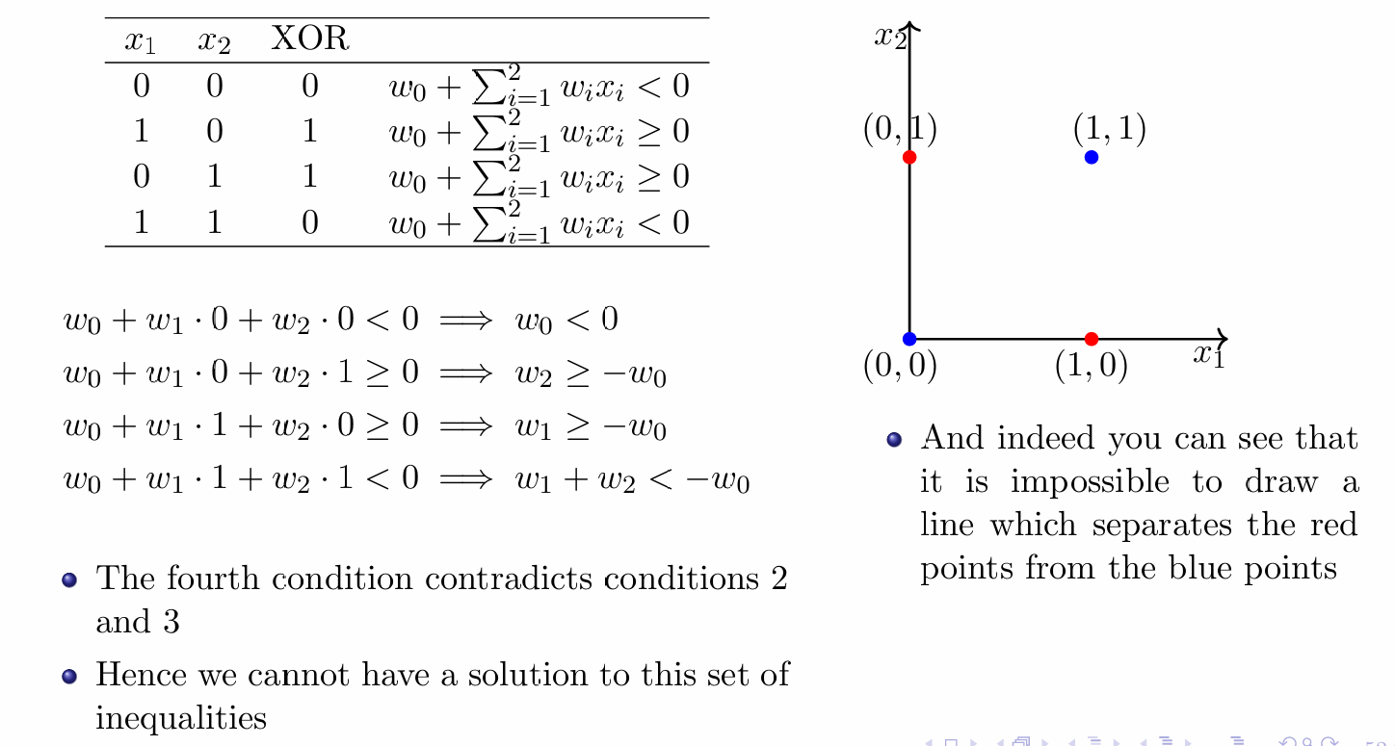
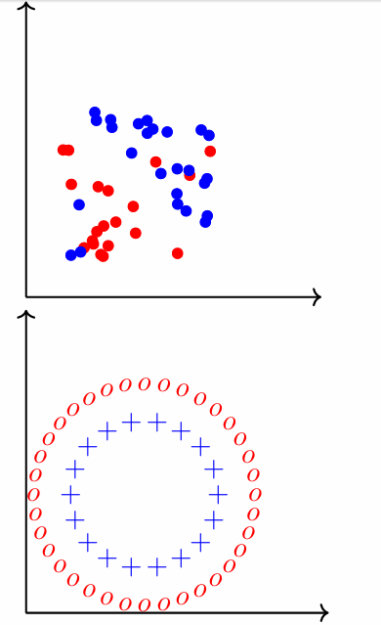
What do we do about functions which are not linearly separable?

Slide 3
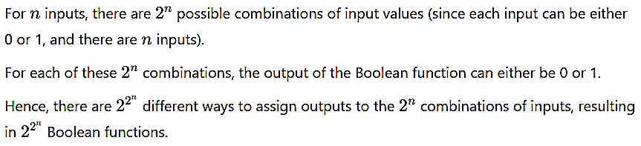
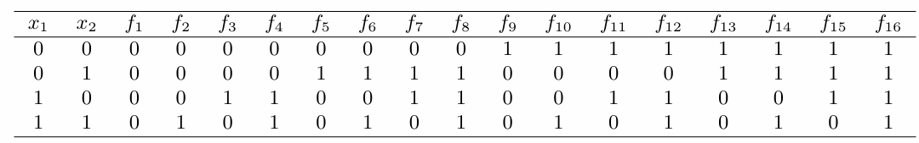
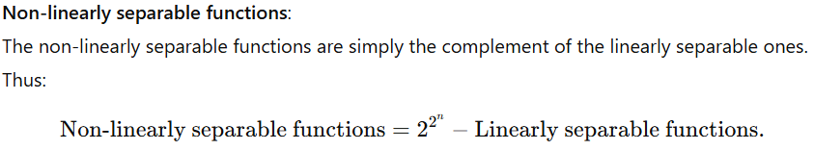
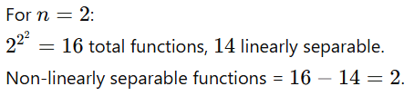
Boolean Functions from Input

Slide 4
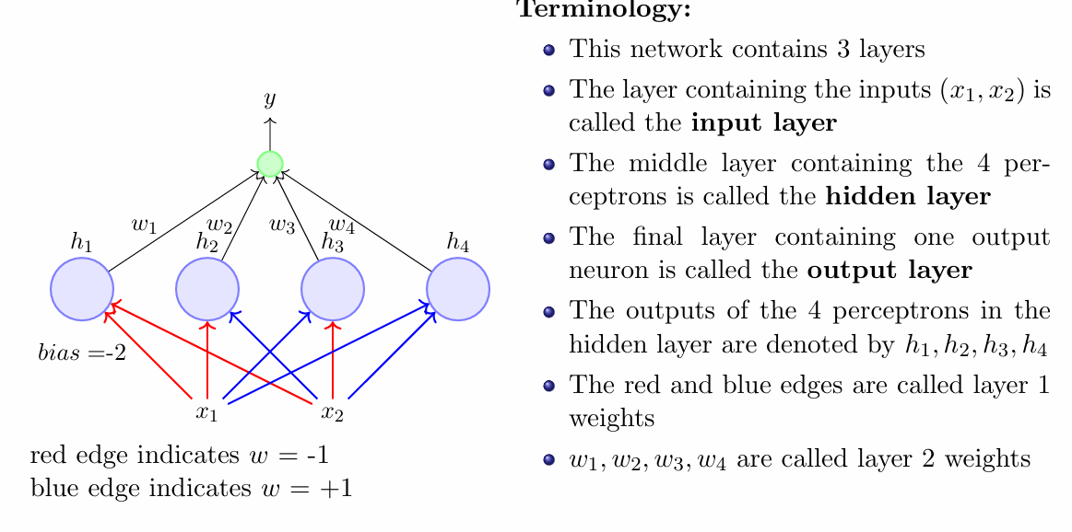
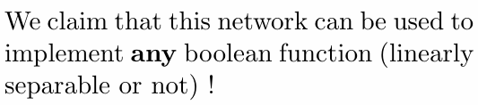
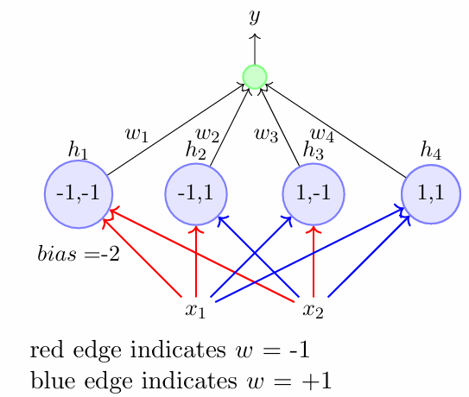
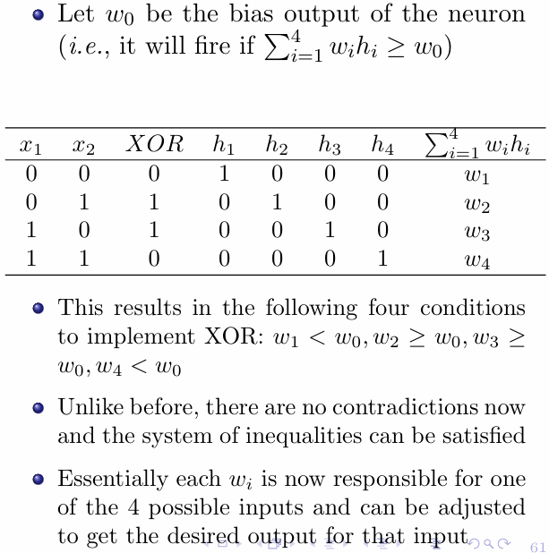
Network of Perceptrons
Implementation to XOR Function

Slide 5
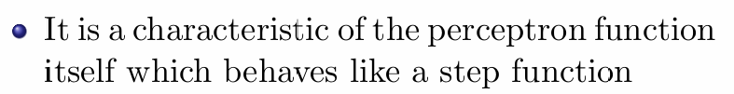
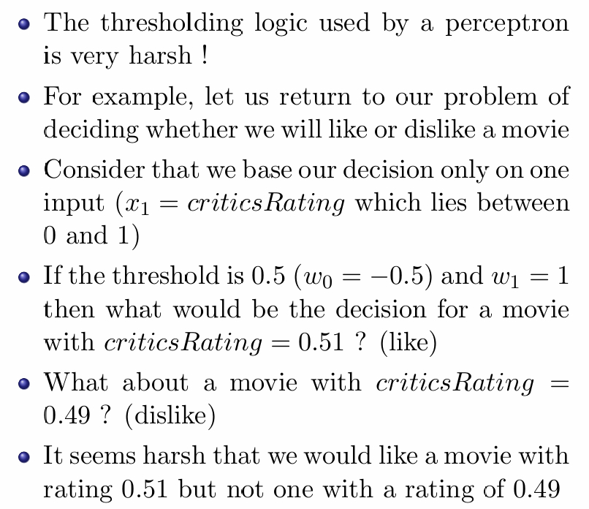
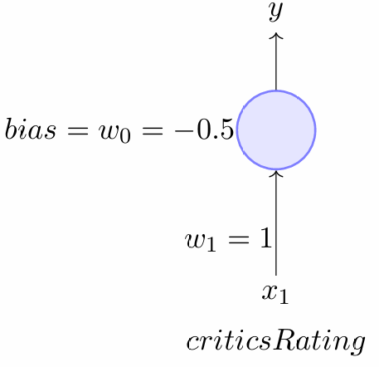
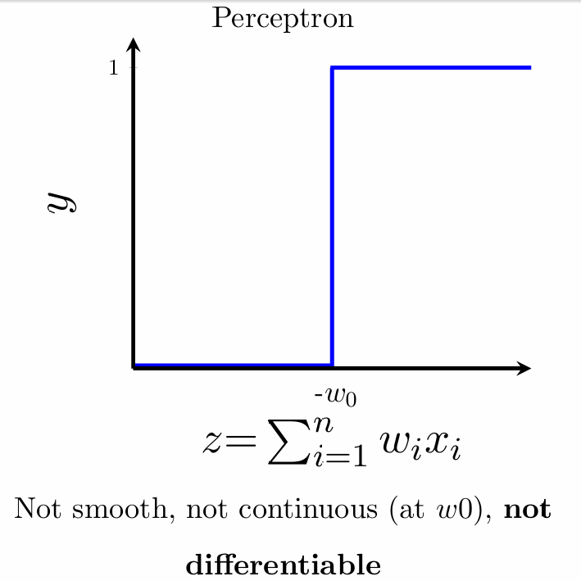
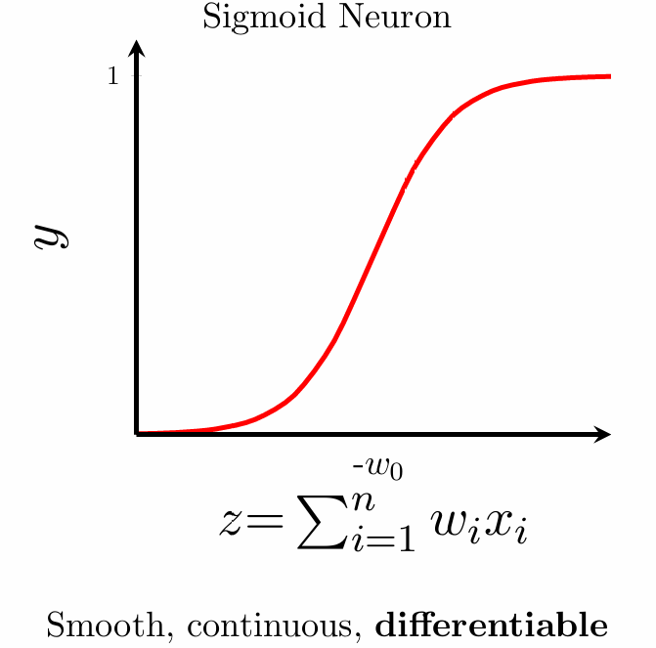
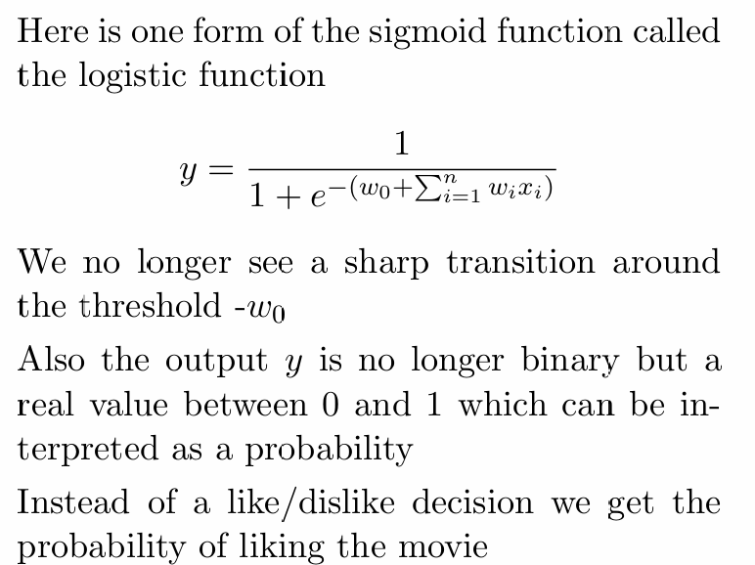
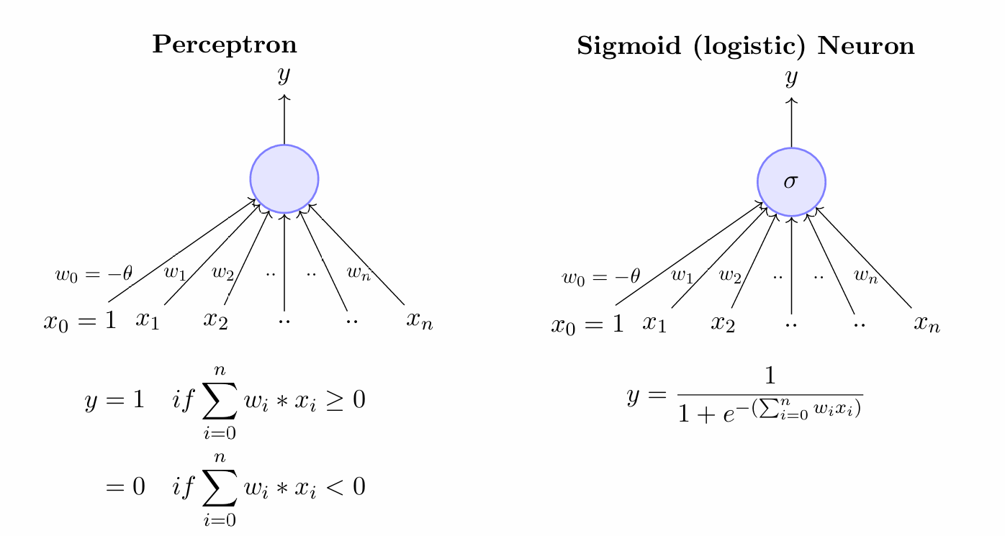
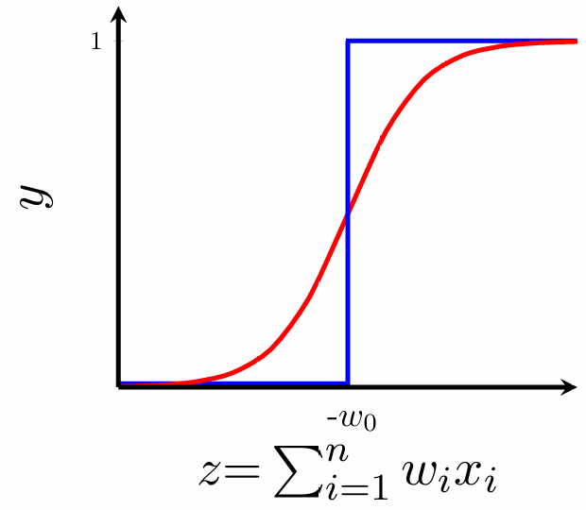
Sigmoid Neuron
Analogy between Perceptron and Sigmoid

Slide 6
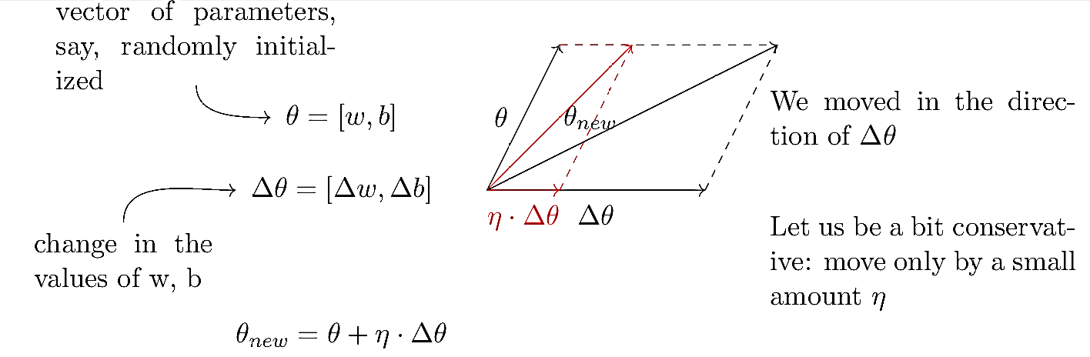
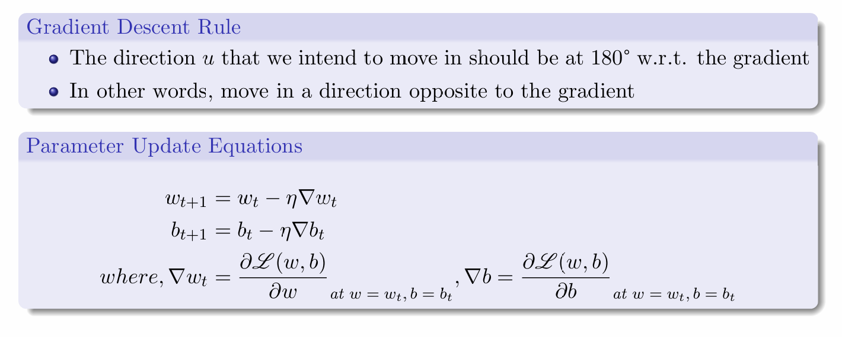
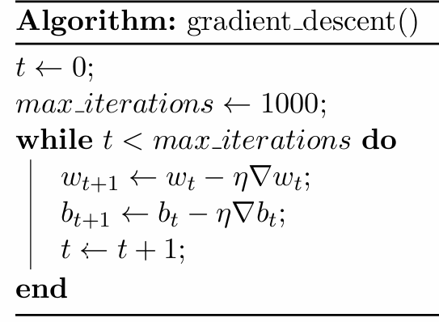
Learning Parameters : Gradient Descent

Slide 7
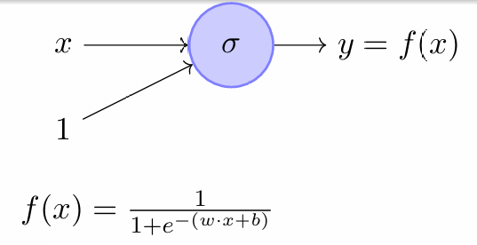
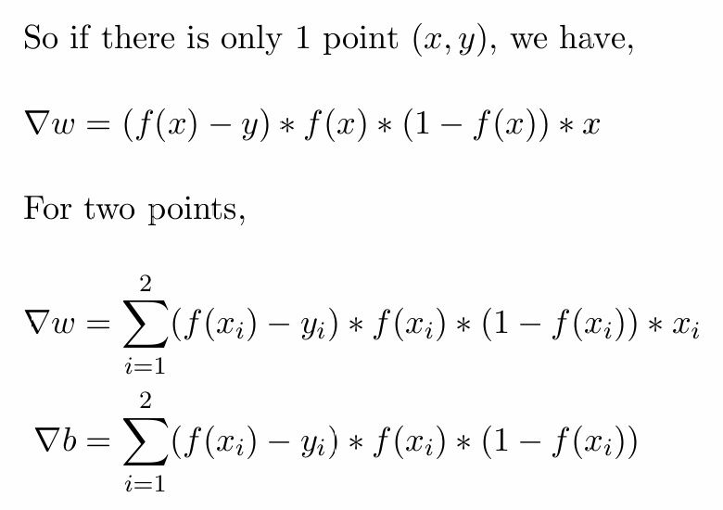
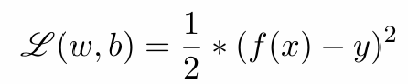
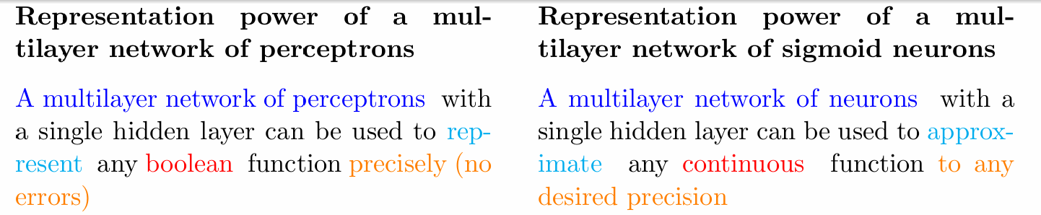
Representation Power of a Multilayer

Slide 8
Topics on which Week 2 Assignment Questions are based
Network of Perceptrons
Sigmoid Neuron
Gradient Descent
Universal Approximation Theorem

Slide 9
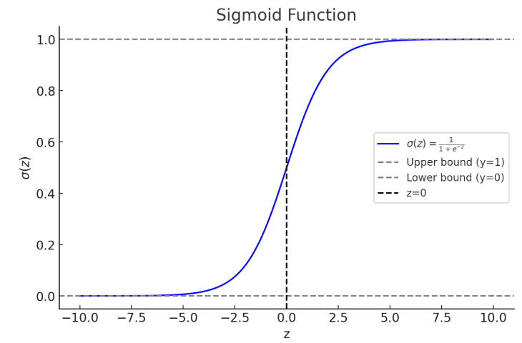
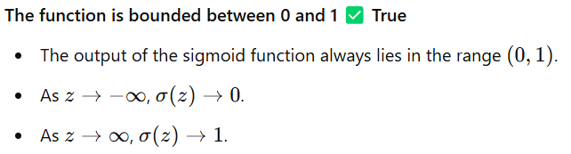
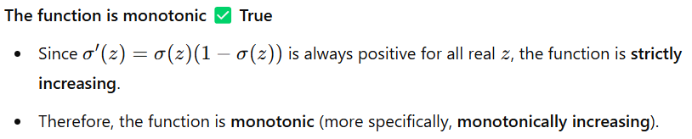
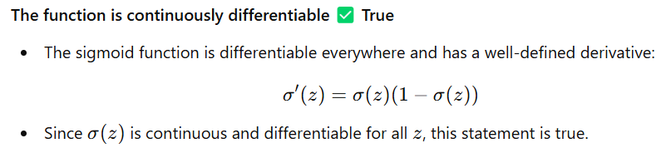
QUESTION 1
Which of the following statements is(are) true about the following function?
a)The function is bounded between 0 and 1
b)The function attains its maximum when z→∞
c)The function is continuously differentiable
d)The function is monotonic
SOLUTION 1
CORRECT ANSWER 1
a), b), c), d)

Slide 10
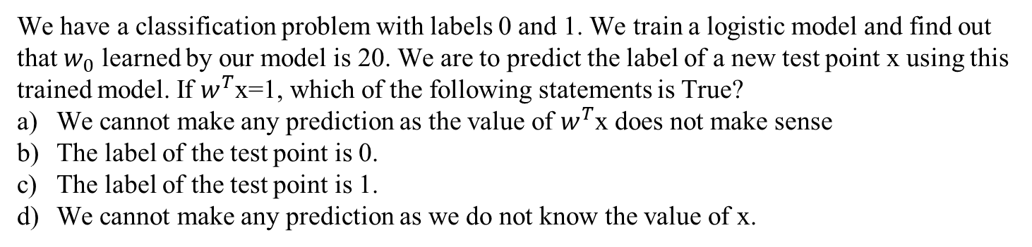
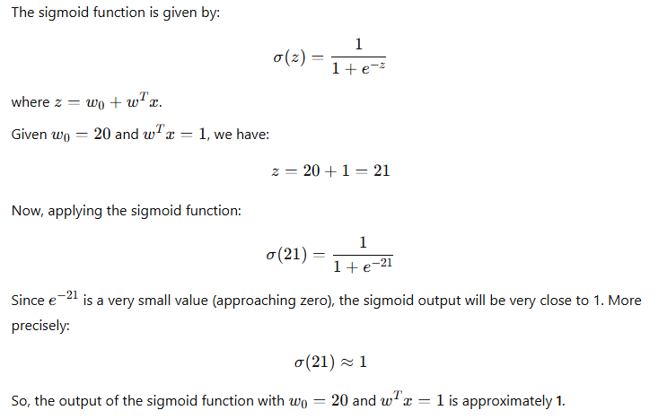
QUESTION 2
SOLUTION 2
CORRECT ANSWER 2
c)

Slide 11
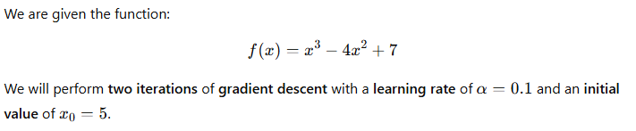
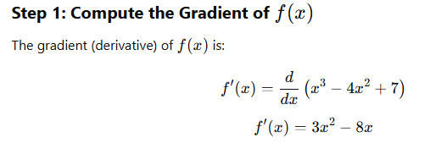
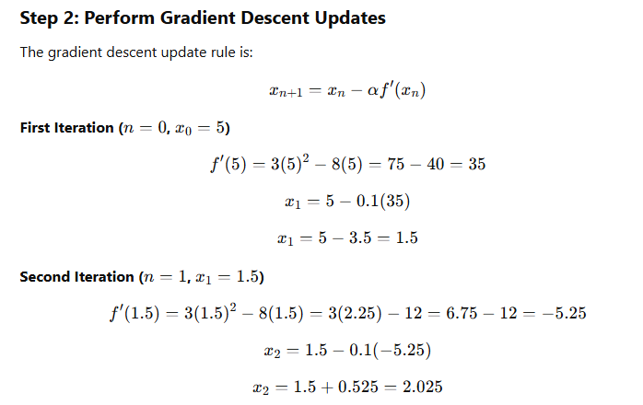

QUESTION 3
SOLUTION 3
CORRECT ANSWER 3
(Type: Range) 2.0,2.1

Slide 12

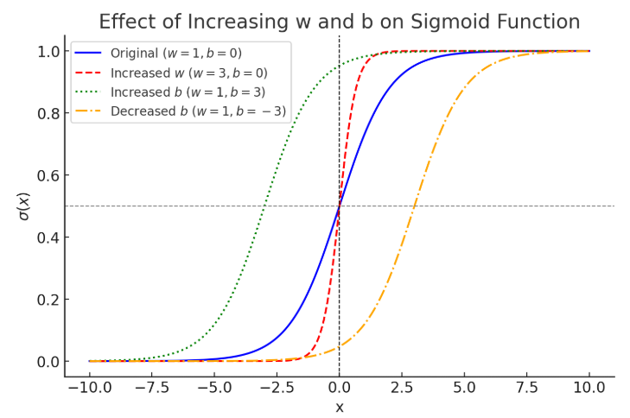
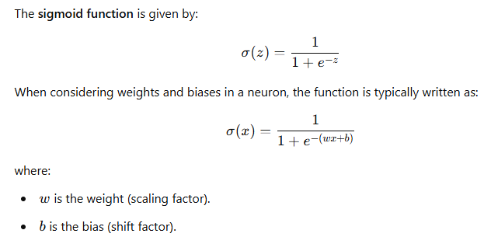
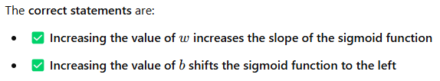
QUESTION 4
Consider the sigmoid function,
where w is a positive value. Select all the correct statements regarding this function.
Increasing the value of w decreases the slope of the sigmoid function
Increasing the value of w increases the slope of the sigmoid function
Increasing the value of b shifts the sigmoid function to the left (i.e., towards negative infinity)
Increasing the value of b shifts the sigmoid function to the right (i.e., towards positive infinity)
SOLUTION 4
CORRECT ANSWER 4
b), c)

Slide 13
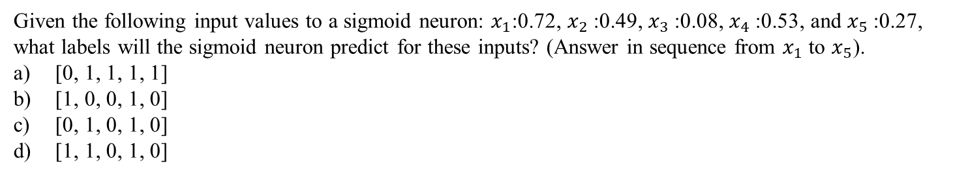
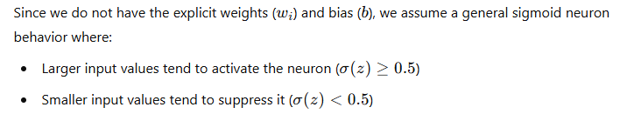
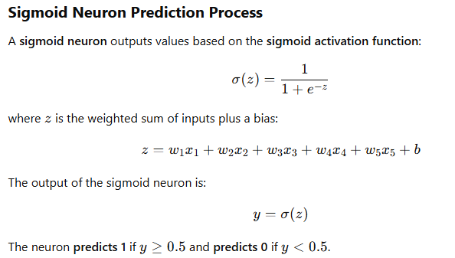
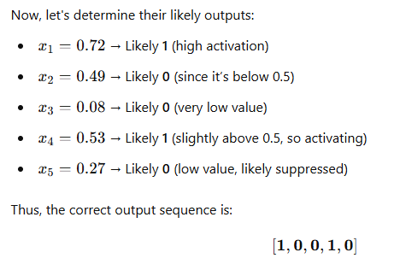
QUESTION 5
SOLUTION 5
CORRECT ANSWER 5
b)

Slide 14
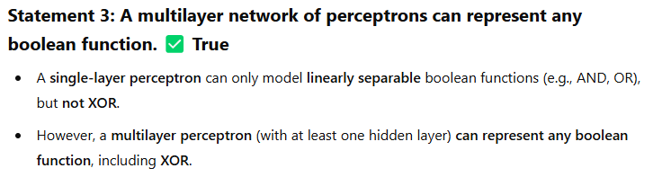
QUESTION 6
Which of the following statements is true about the representation power of a multilayer network of perceptions?
A multilayer network of perceptrons can represent any function.
A multilayer network of perceptrons can represent any linear function.
A multilayer network of perceptrons can represent any boolean function.
A multilayer network of perceptrons can represent any continuous function.
SOLUTION 6
CORRECT ANSWER 6
c)

Slide 15
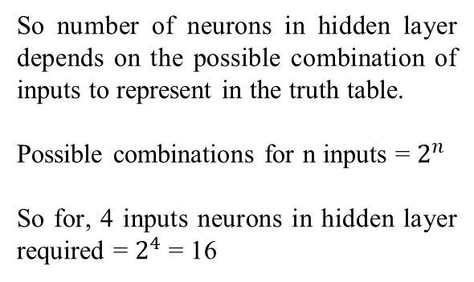
QUESTION 7
How many neurons do you need in the hidden layer of a perceptron to learn any boolean function with 4 inputs? (Only one hidden layer is allowed)
16
64
56
32
SOLUTION 7
For 2 inputs XOR function
CORRECT ANSWER 7
a)

Slide 16
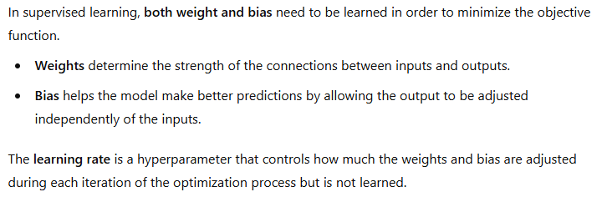
QUESTION 8
Which parameters need to be learnt in minimizing objective function in supervised
learning?
Only Weight
Only Bias
Both Weight and Bias.
Learning rate
SOLUTION 8
CORRECT ANSWER 8
c)

Slide 17
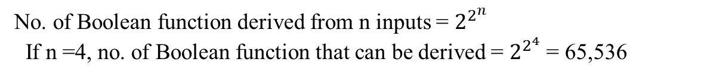
QUESTION 9
How many boolean functions can be designed for 4 inputs?
65,536
8
256
64
SOLUTION 9
CORRECT ANSWER 9
a)

Slide 18
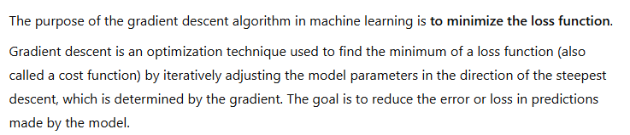
QUESTION 10
What is the purpose of the gradient descent algorithm in machine learning?
To minimize the loss function
To maximize the loss function
To minimize the output function
To maximize the output function
SOLUTION 10
CORRECT ANSWER 10
a)

